Slide 1
Ariel Ferrante, Roxana Savin, Gustavo A Slafer. J Exp Bot. 2013 Jan; 64 (1): 169-84.

Slide 2
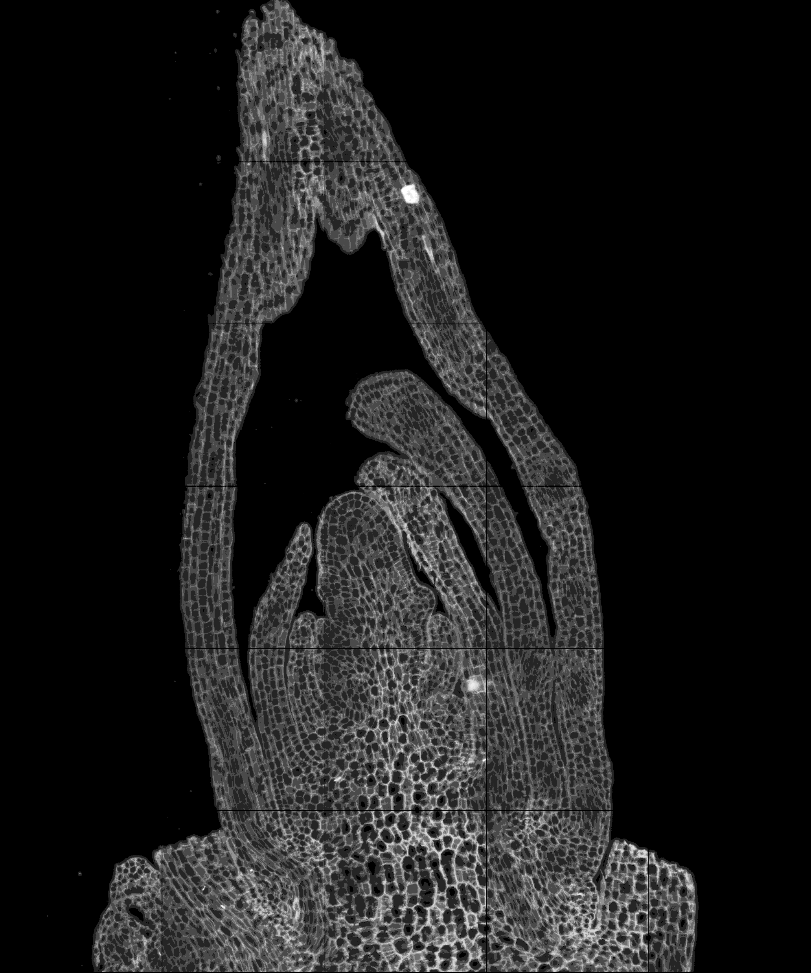
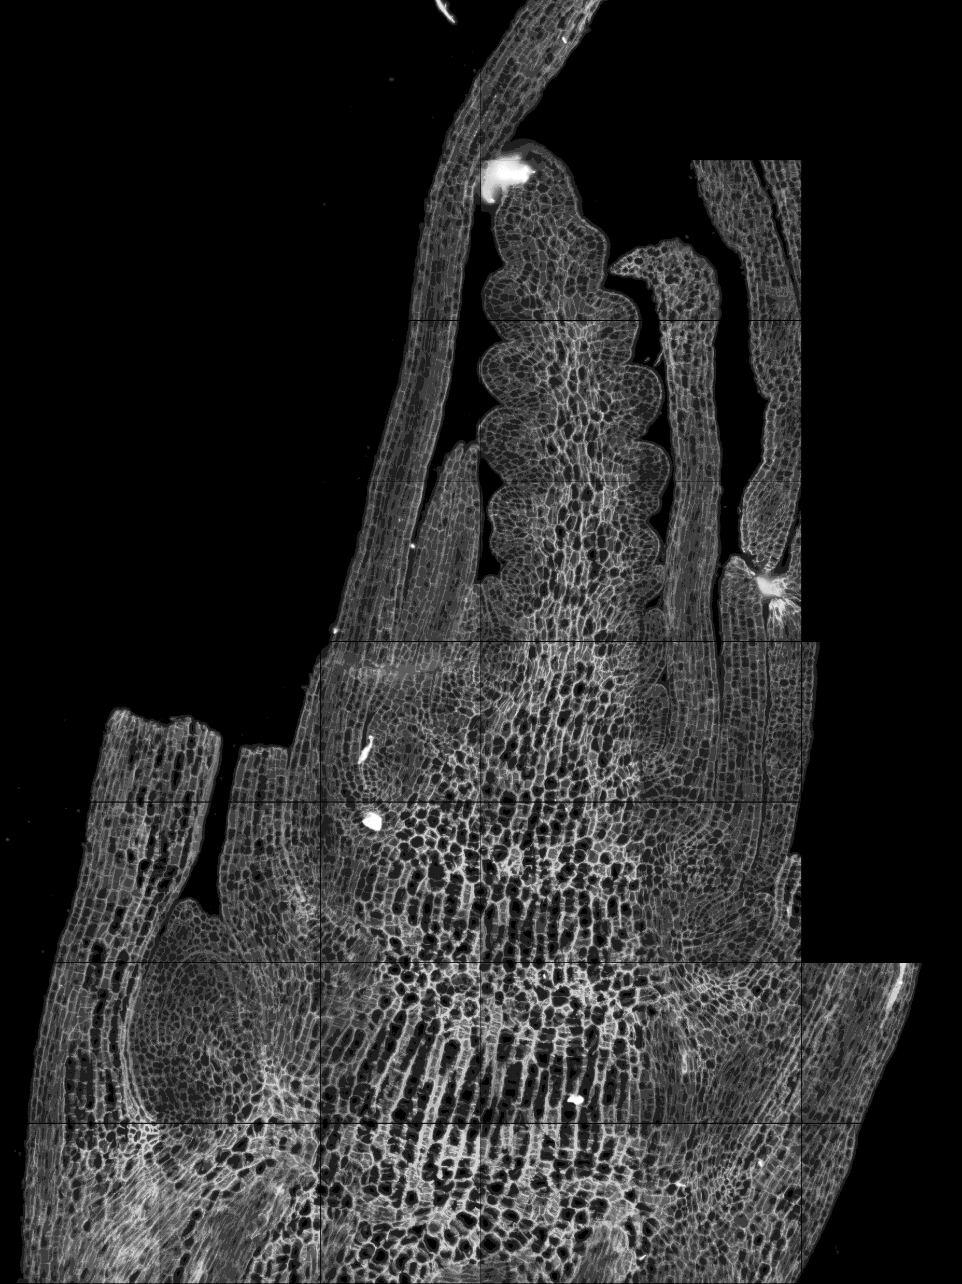
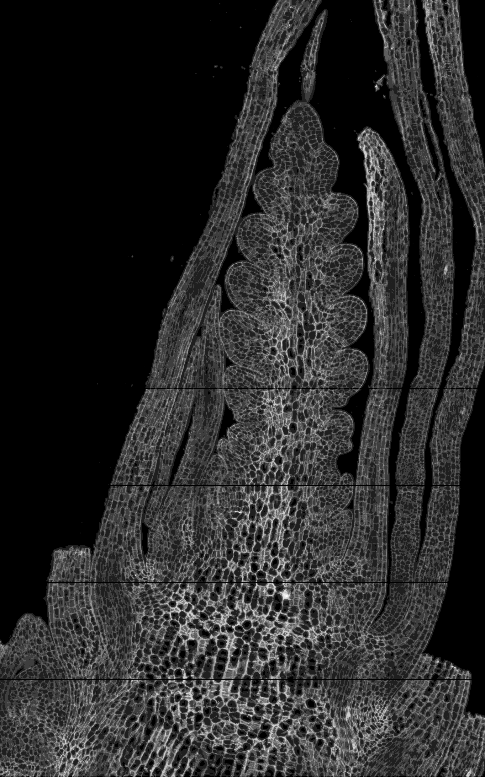
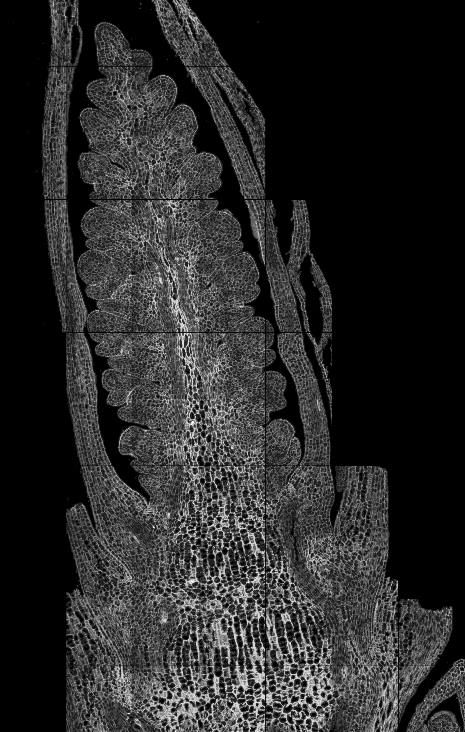
W1.5
W2.5
W3.0
W3.25
C1-1
C2-4
B2-4
A1-2

Slide 3
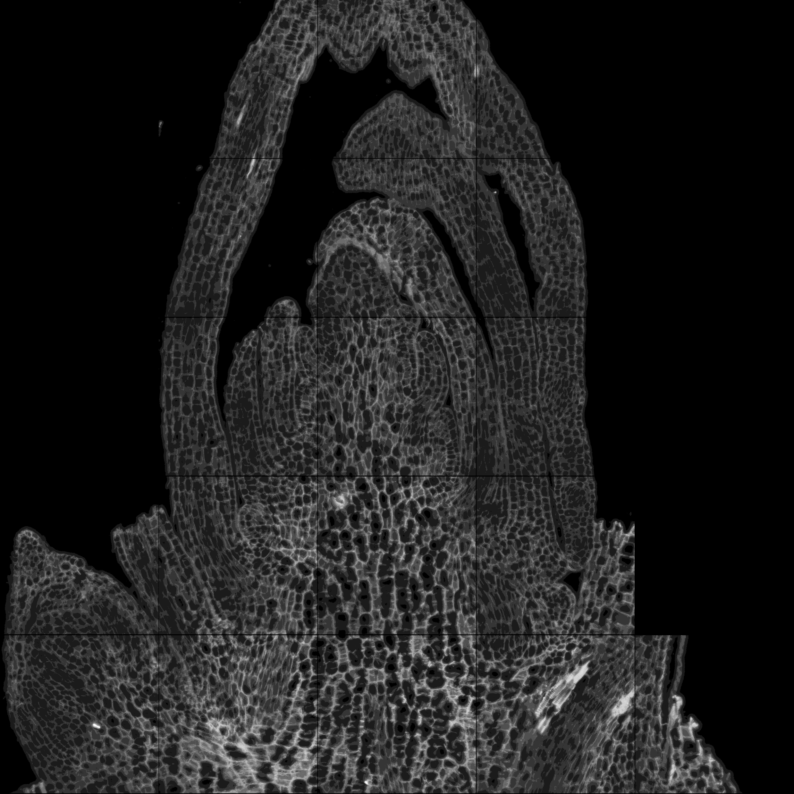
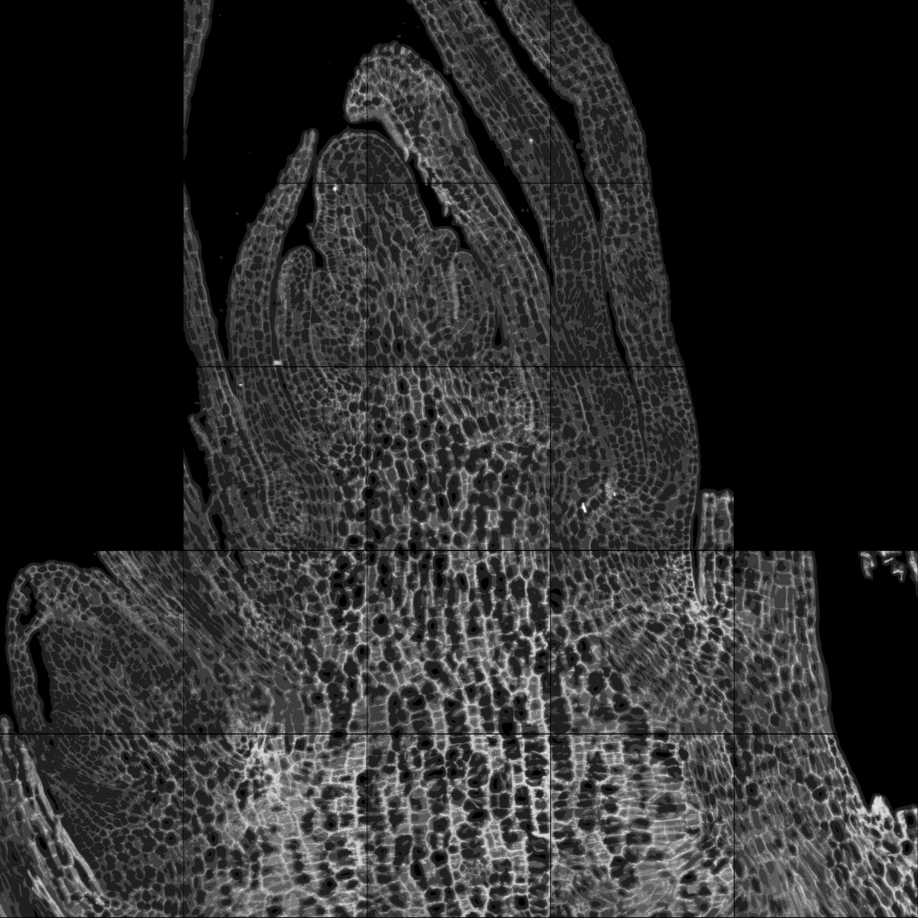
Waddington stage 1.5 (W1.5)
C1-1
D-1
D-2

Slide 4
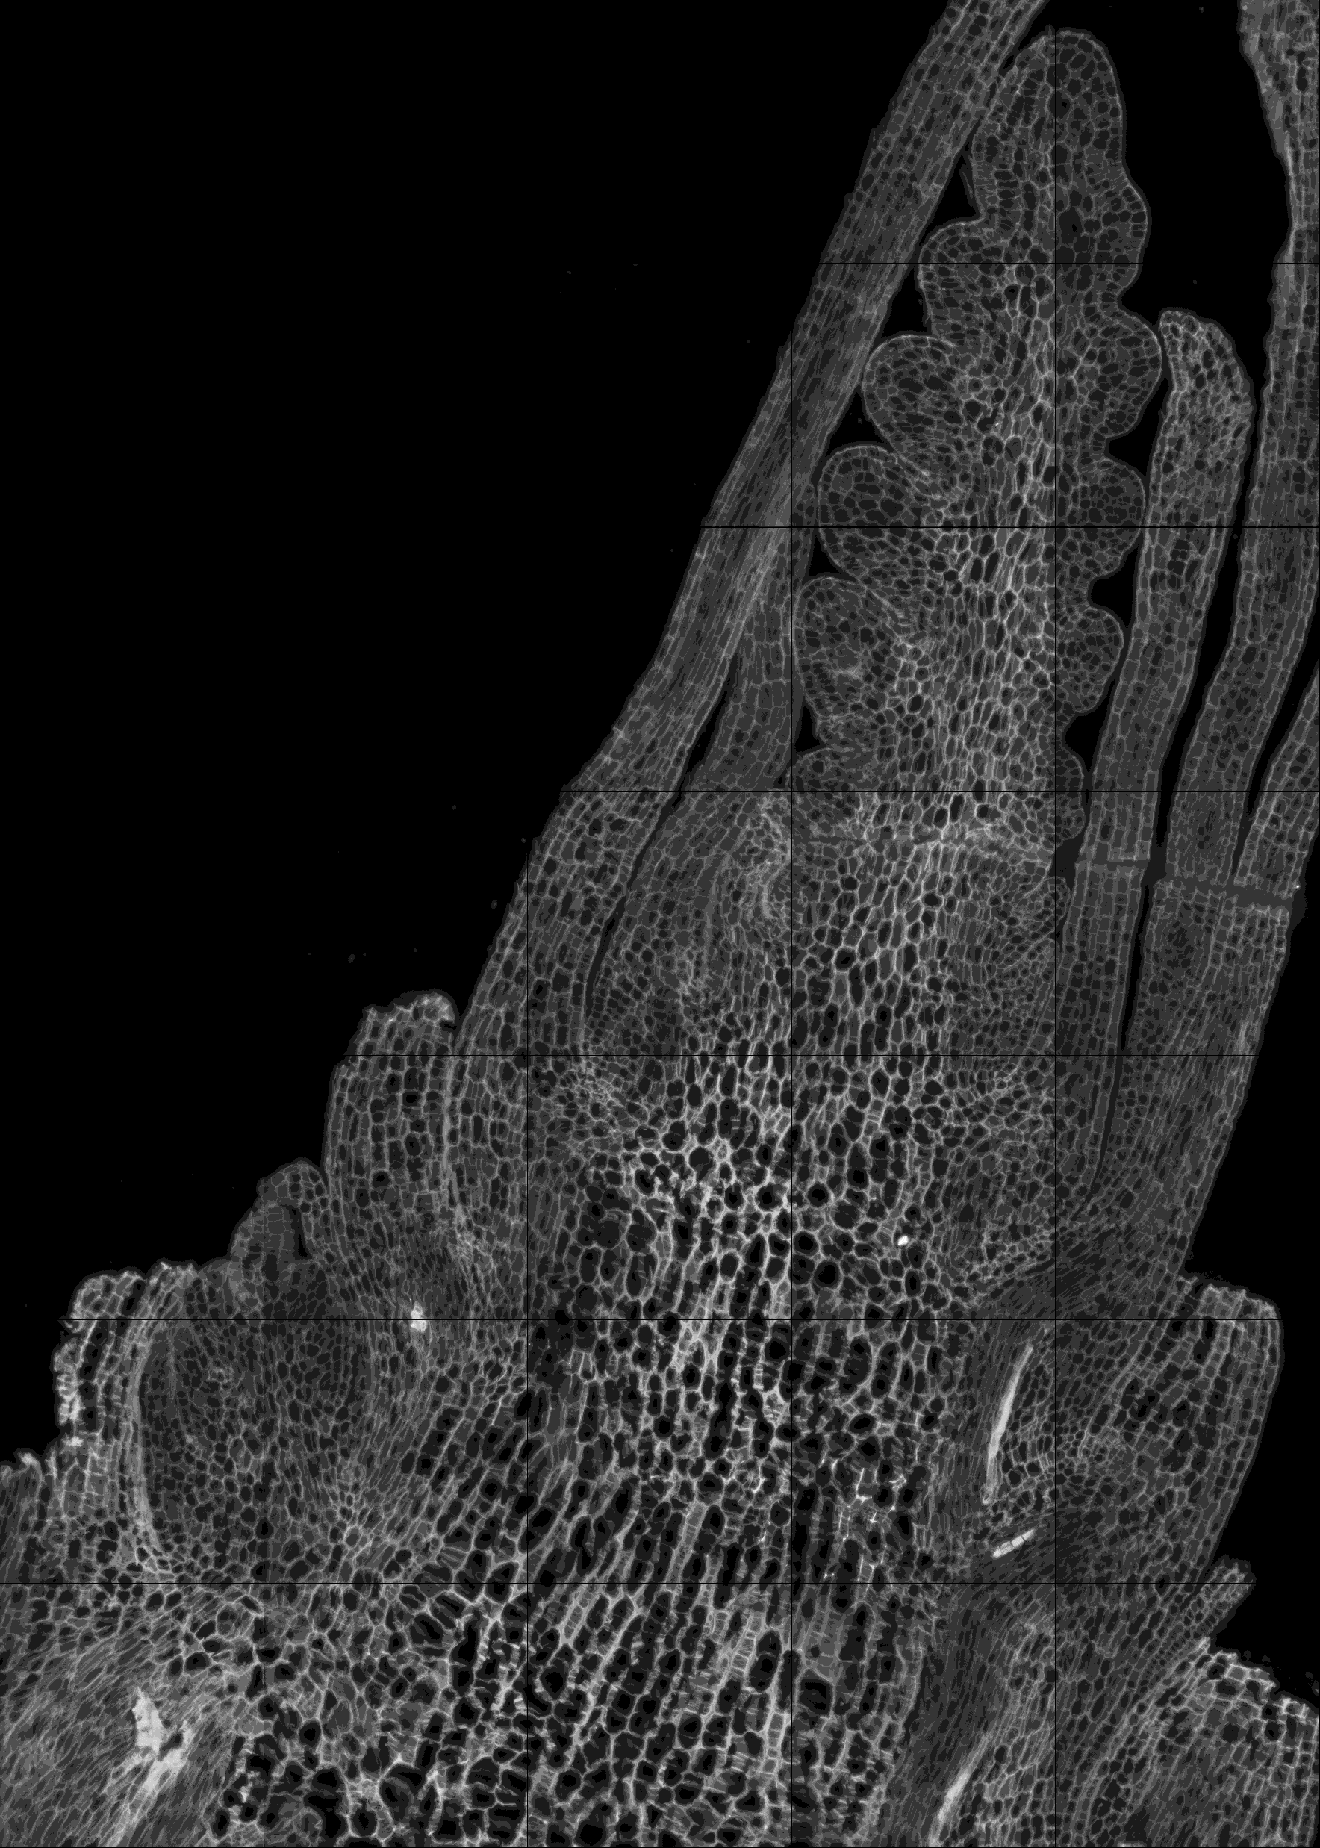
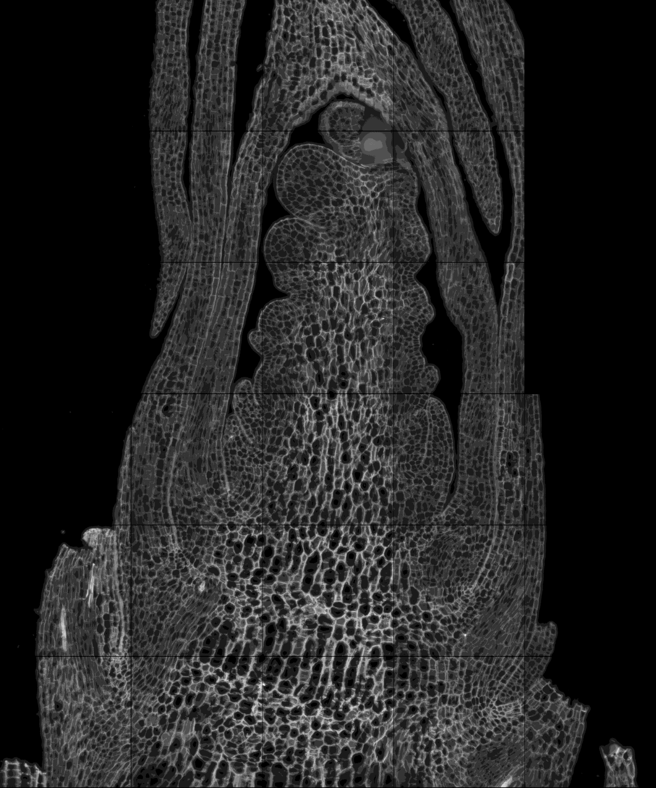
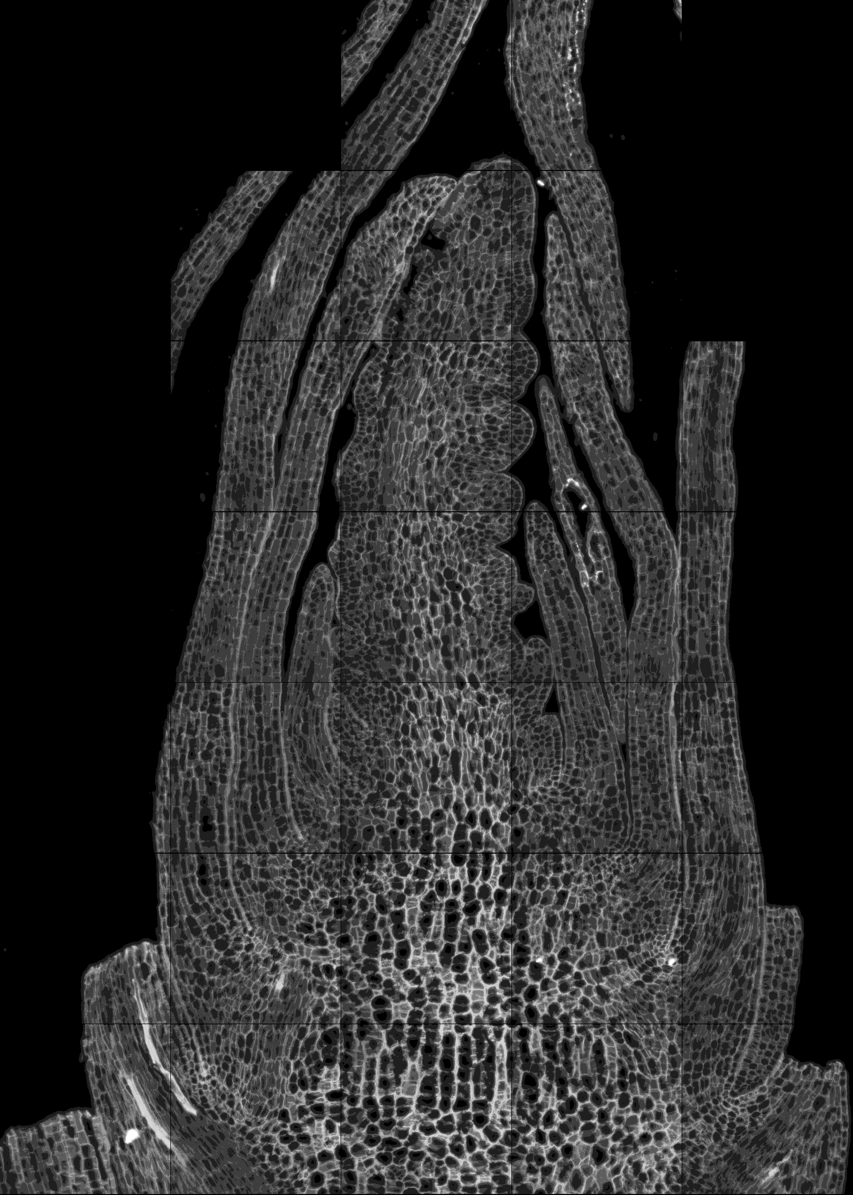
Waddington stage 2.5 (W2.5)
C2-3
C2-4
D2-1
D2-2

Slide 5
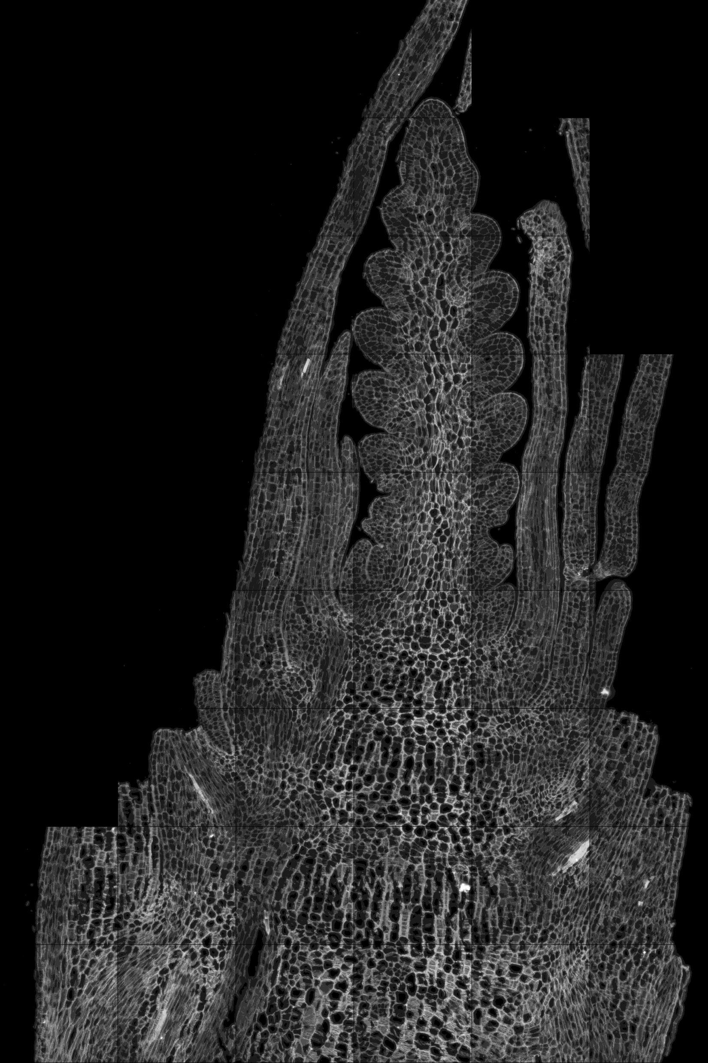
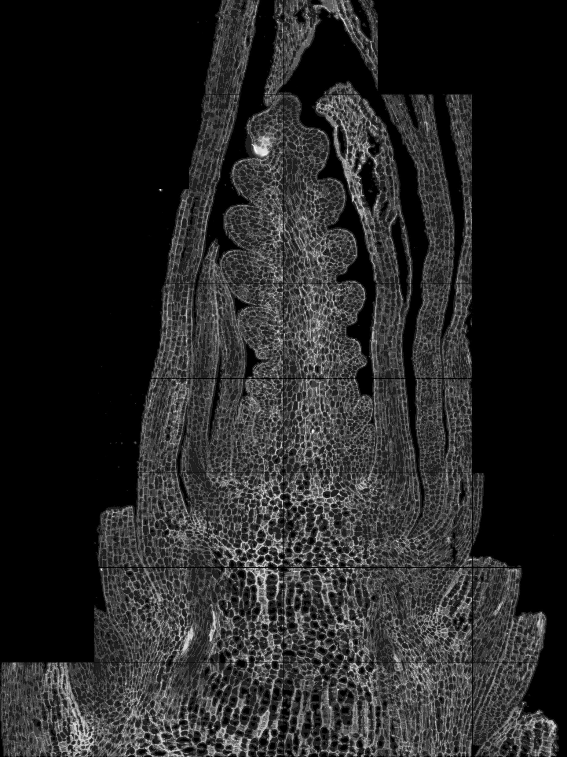
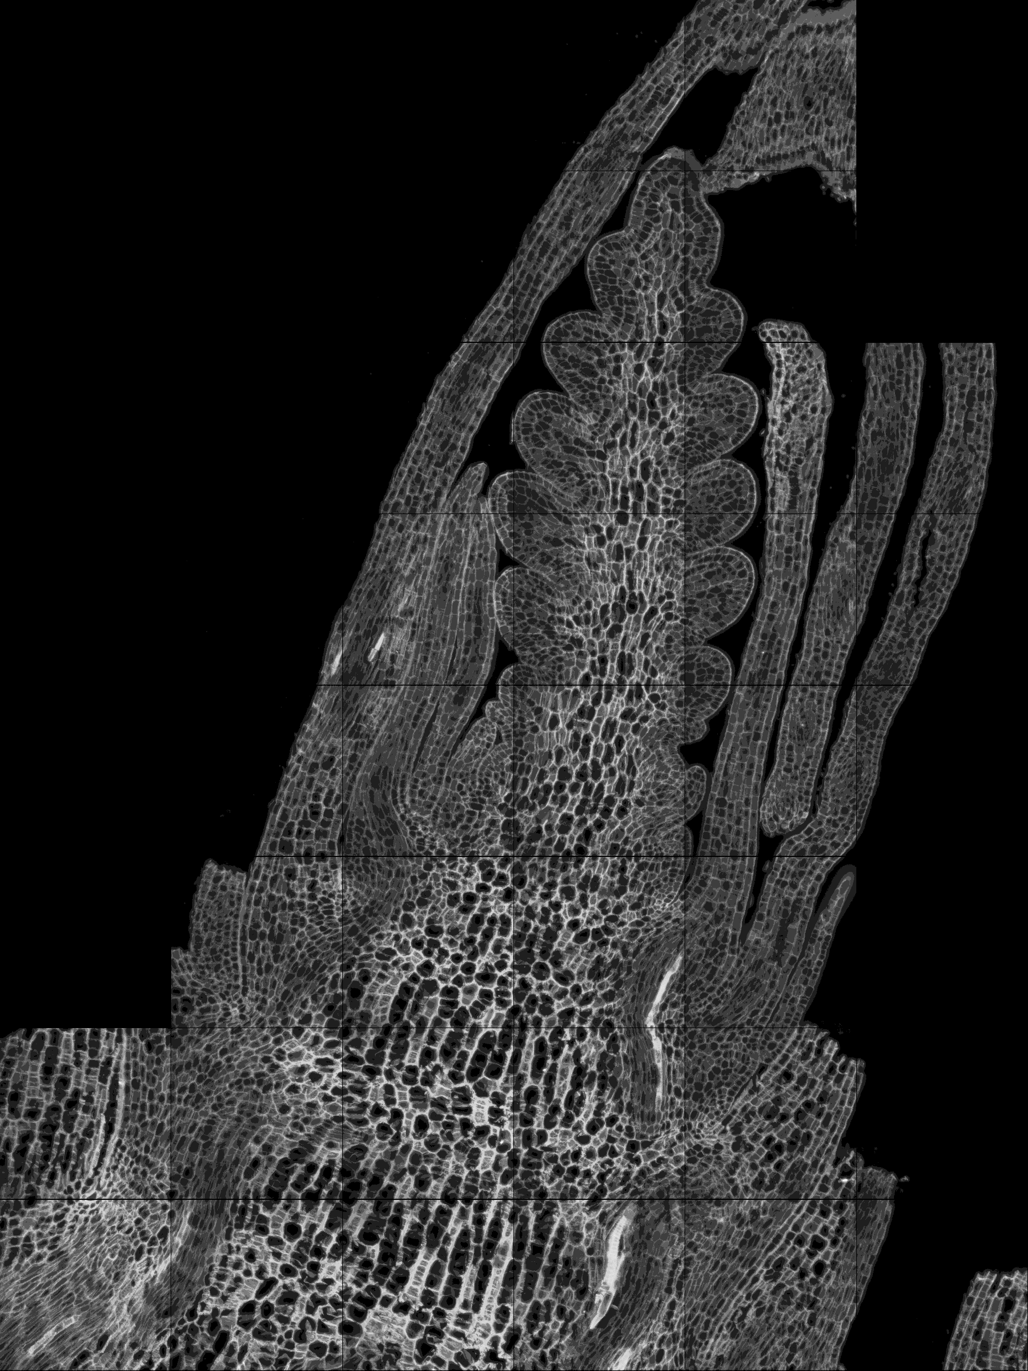
Waddington stage 3.0 (W3.0)
B1-3
B1-4
B2-4
B2-5

Slide 6
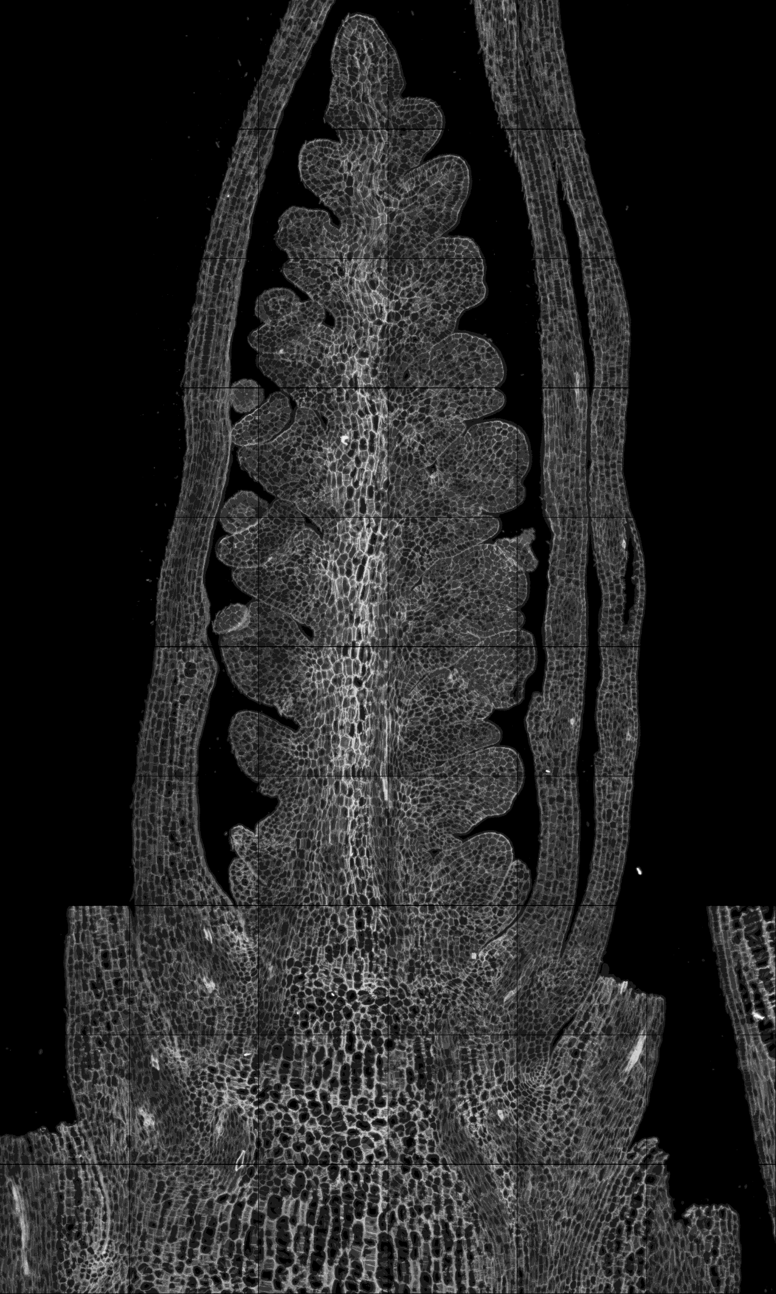
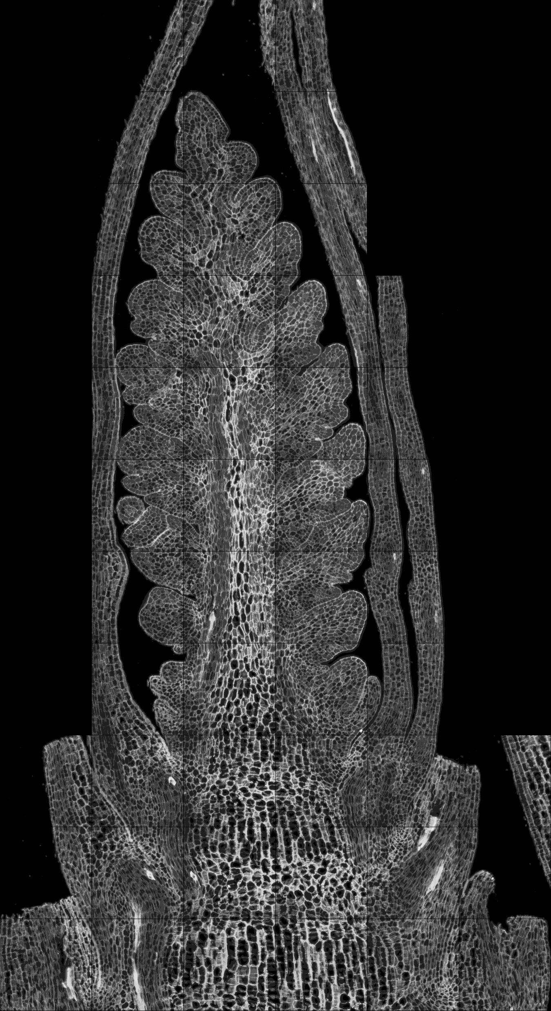
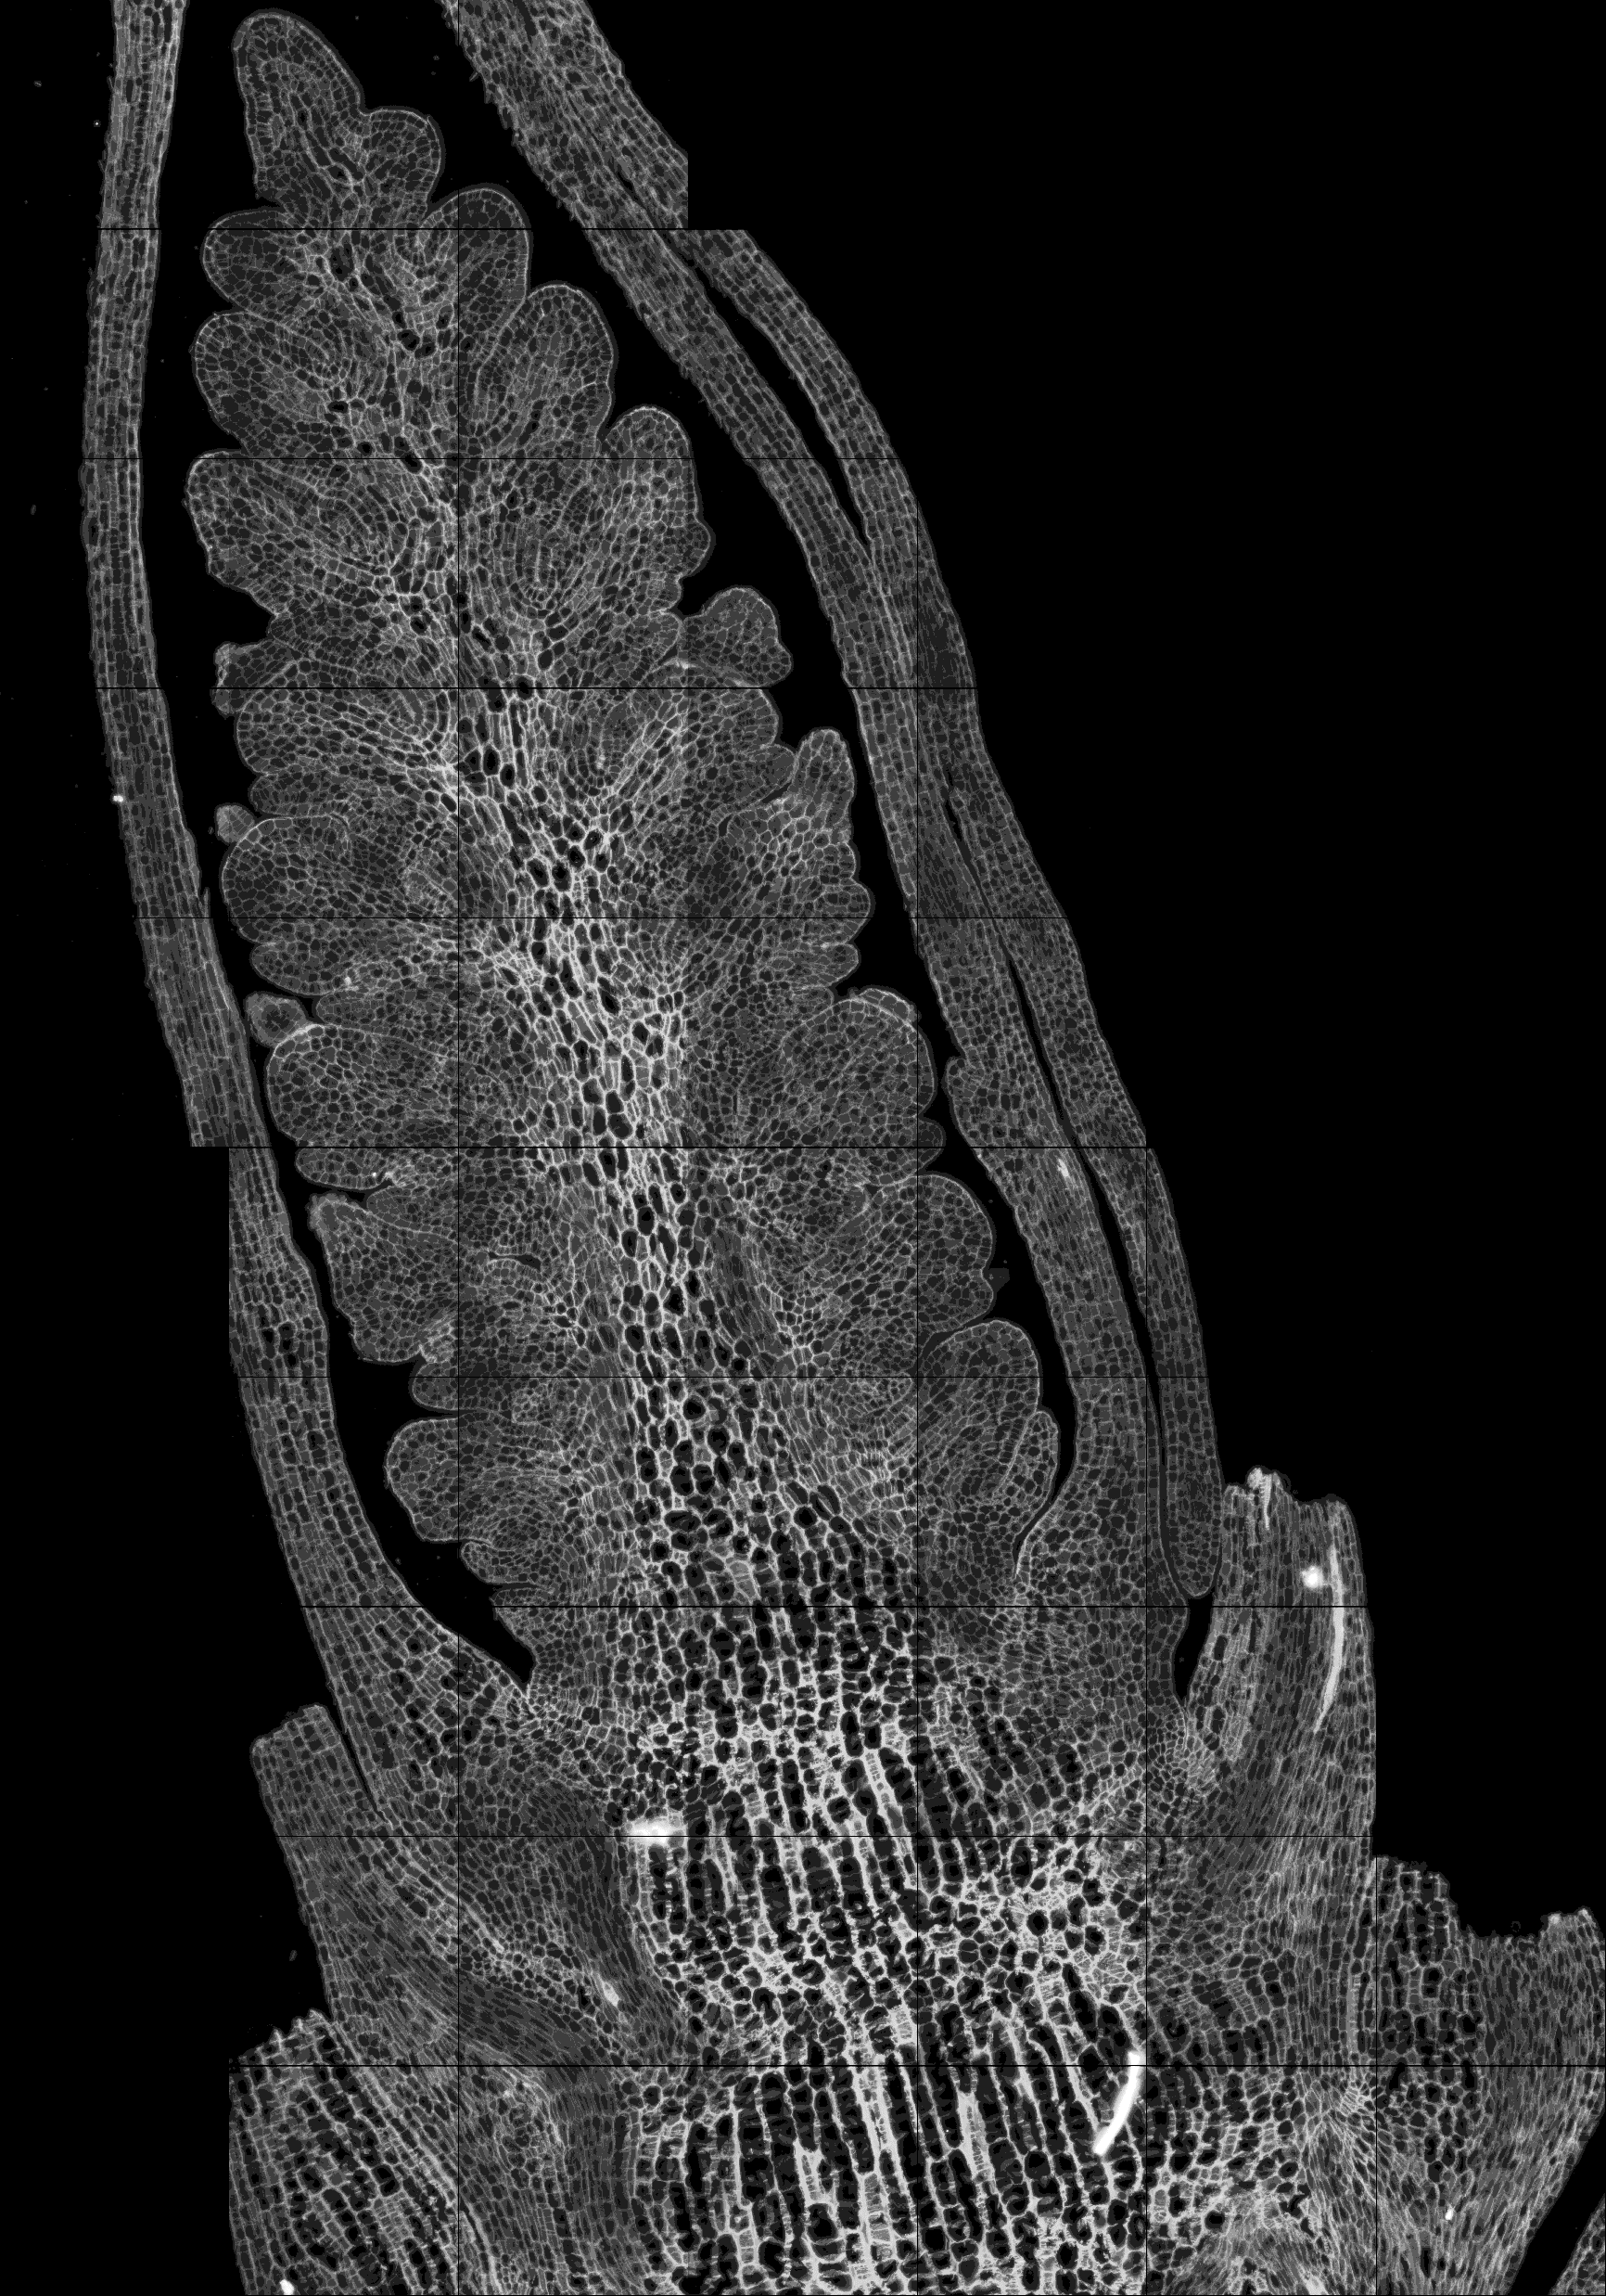
Waddington stage 3.25 (W3.25)
A1-1
A1-2
A2-1
A2-2

Slide 7
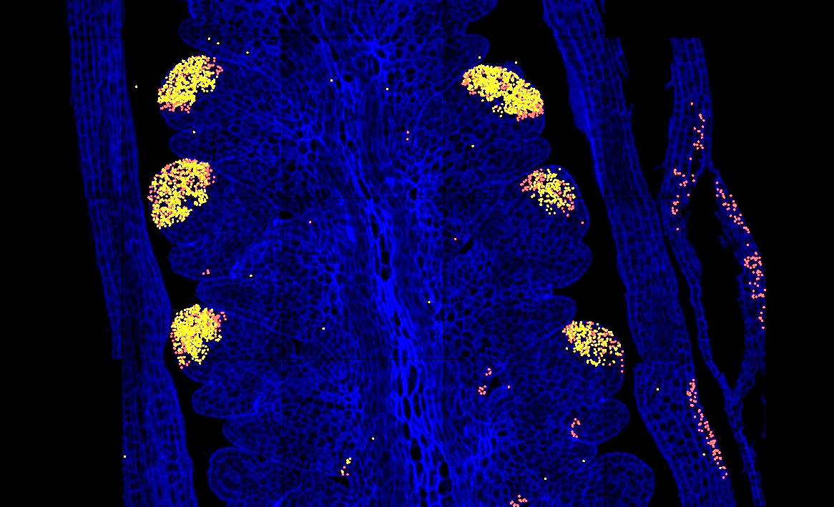
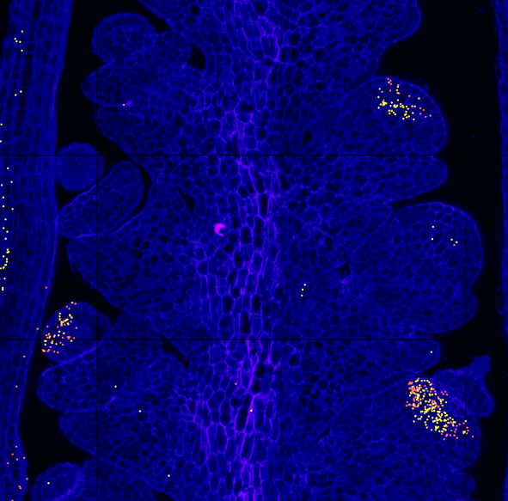
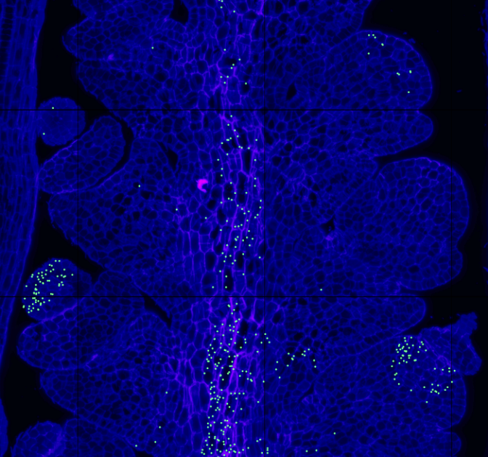
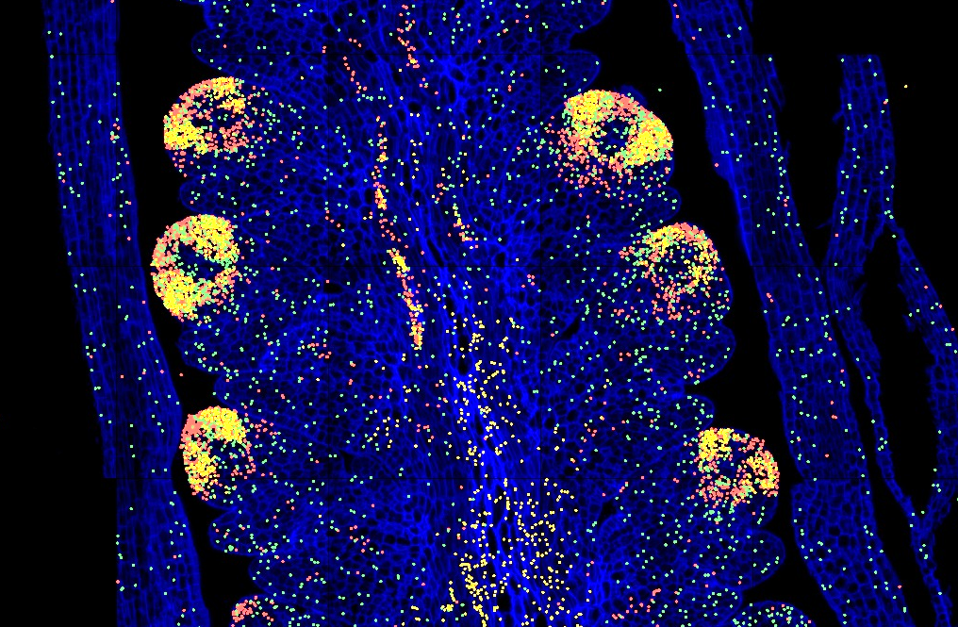
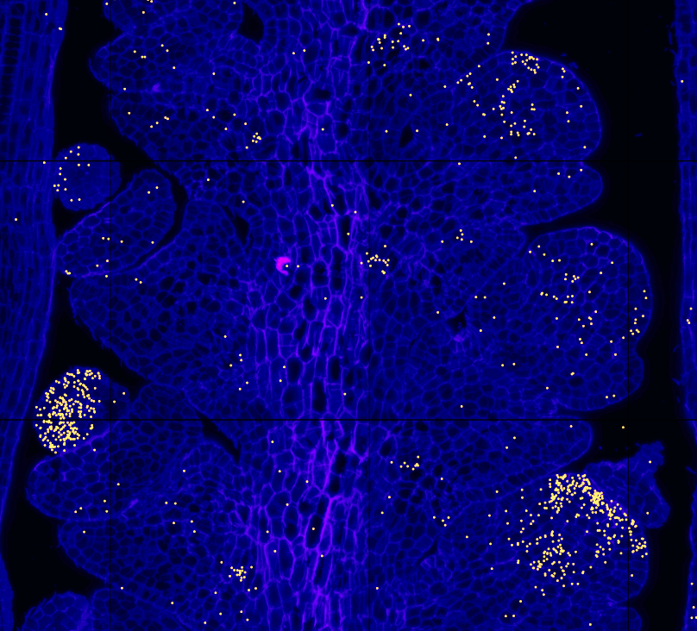
Note on sections A1 and A2 (W2.25, lemma primordia): Some of the central spikelet meristems are starting to show expression of floral MADS-box genes AG1, AG2, AP3 and PI-1, suggesting the initiation of a transition to florets and flowers that are characteristic of W3.5 (floret primordia stage).
A1.2
A1.1
AG1
AG2
AG1
AG2
AP3
AP3
PI.1
PI.2
PI-1

